Slide 1
Creating Self-Authorship in Advising Interactions with ‘drifting’ students
Presented by Megan Schaefer
Academic Success Coach, University of Nebraska-Lincoln
Academic Advising Association Conference
February 23, 2015

Slide 2
Today we will cover:
My background and how I approach Self-Authorship
Create a profile of ‘drifting’ students
The theory of Self-Authorship and it’s components
Learning Partnerships Models
Share ways we already use Learning Partnerships Models three principles
Determine one thing we would like to implement in our work with students

Slide 4
Who are these ‘drifting’ students?
Why are they challenging to work with?
They don’t know what they want
Sometimes do not seem interested in determining their interests or wants
Often struggling in school
Easier to tell them what to do
Non-committal
Want things to be different but don’t want to do what you are suggesting

Slide 5
Why is promoting self-authorship a helpful advising tool?
Pizzolato (2008) describes how advisors promoting self authorship can help students:
Choose appropriate majors
Increase their use of critical thinking to make choices
Develop healthier relationships with diverse individuals
(Increase student’s overall satisfaction with life)
“When advising interactions are rooted in students’ own experiences rather than in generic skill development exercises, students are more apt to use the resulting personally constructed strategies in new academic situations.” (p. 23)
Pizzolato, J. E. (2008). Advisor, teacher, partner: Using the learning partnerships model to reshape academic advising. About Campus, 13(1), 18-25. doi:10.1002/abc.243

Slide 6
Theory of Self-Authorship Marcia Baxter Magolda (2001)
Moving from an external definition to an internal definition of:
how you know (cognitive/epistemological)
who you are (intrapersonal)
how to interact with others (interpersonal)
Formed as a result of longitudinal study
Three dimensions and four phases
Baxter Magolda, M. (2001). Making their own way: Narratives for transforming higher education to promote self-development. Sterling, VA: Stylus Publishing.

Slide 7
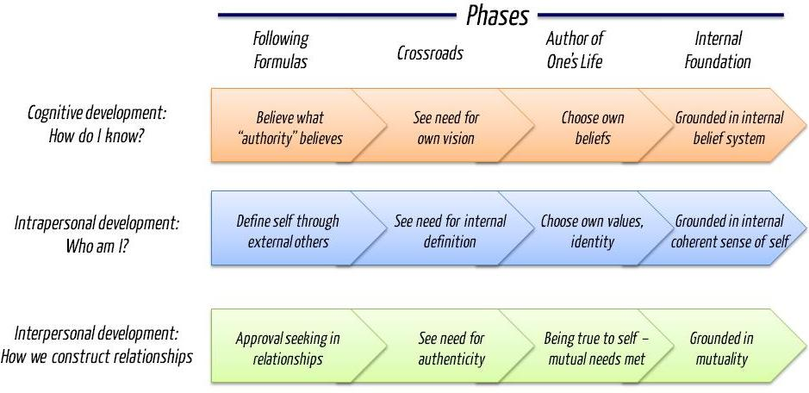
Boe, J. (2011, April 28). Who are you? Self-authorship defined [Web log comment]. Retrieved from: https://imjoeboe.wordpress.com/2011/04/28/self-authorship/

Slide 8
What phase are ‘drifting’ students often in?

Slide 9
Learning Partnerships Model
Brings the spirit of Self-Authorship alive in a way you can share with students
Ways to help students listen to, and use, their internal voice
Analogy of the two-seat bicycle: we should be behind the student, supporting the movement forward and helping the balance, but not steering
Baxter Magolda, M. B., & King, P. M. (2004). Learning partnerships: Theory and models of practice to educate for self-authorship. Sterling, VA: Stylus.

Slide 10
Core Assumptions
Three Principles
*Help challenge students’ dependence on authority
Knowledge is complex and socially constructed
An internal sense of self is central to knowledge construction
Expertise and authority are shared in the mutual construction of knowledge
*Foster self-authorship
Validate learners as knowers
Situate learning in learners’ experience
Define learning as mutually constructing meaning
Baxter Magolda, M. B., & King, P. M. (2004). Learning partnerships: Theory and models of practice to educate for self-authorship. Sterling, VA: Stylus.

Slide 11
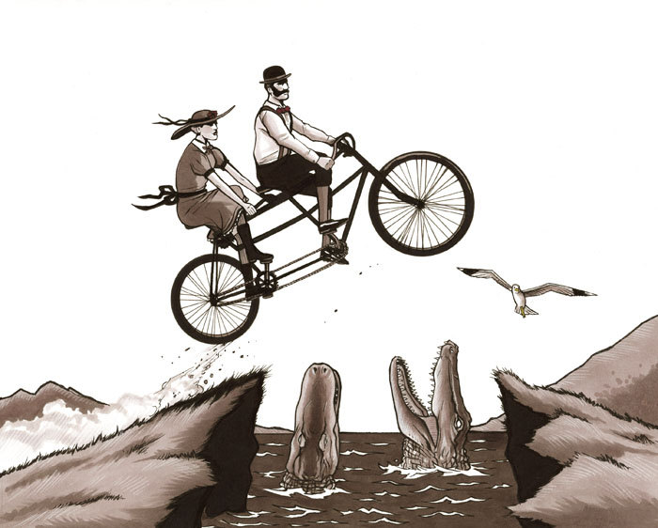
Discussion of three principles (Using LPM)
Notes:
Would anyone be willing to write?

Slide 12
Principle 1: Validate learners as knowers
How:
Encourage active sharing of ideas
Let student know you care about their opinion and ideas
Break down idea of advisor as “authority”
Determining student’s situation
Davidson, D. L. (2011). Teacher Tip #2: Self-Authorship & the Learning Partnerships Model. Teaching & Learning Enhancement Center Teaching Tips. Bloomsburg, PA: Bloomsburg University.
Pizzolato, J. E. (2008). Advisor, teacher, partner: Using the learning partnerships model to reshape academic advising. About Campus, 13(1), 18-25. doi:10.1002/abc.243
Notes:
On flip chart “P1: Learners as knowers” Strategies:
Tell me about a time when you finished a hard task…
What are some ways you’ve worked through that problem in the past?
What was your last semester like?
What was your high school (last academic experience) like?
You’re the expert on what you are experiencing.
Last time we spoke, you talked about wanting to read before you go to class.

Slide 13
Principle 2: Situating learning in the learner’s own experience
How:
Talk about student’s specific experience and use their experience as you discuss their academic plans, skills, choices
Share stories and analogies that relate to student experience
Relate material back to student’s life
Use self-reflection
Offer guidelines, not requirements
Davidson, D. L. (2011). Teacher Tip #2: Self-Authorship & the Learning Partnerships Model. Teaching & Learning Enhancement Center Teaching Tips
Pizzolato, J. E. (2008). Advisor, teacher, partner: Using the learning partnerships model to reshape academic advising. About Campus, 13(1), 18-25. doi:10.1002/abc.243
Notes:
Sticky Note 2, LP 2: Situate learning in Learner’s experience
Based on your experience with classes last semester, what do you want to change?
So last semester you were happy with your grades and time management. How do you make sure this continues?
Start, stop, continue exercise
I thought I was going to major in xyz… after one semester, I learned this was not the case.
Creating a list of options

Slide 14
Principle 3: Define learning as mutually constructing meaning
How:
Joint problem solving
Share your decision making and learning processes with students
Transparency
Asking ‘why’ and ‘how’
Considering impact of decisions
Stressing PROCESS and not PRODUCT
Davidson, D. L. (2011). Teacher Tip #2: Self-Authorship & the Learning Partnerships Model. Teaching & Learning Enhancement Center Teaching Tips
Pizzolato, J. E. (2008). Advisor, teacher, partner: Using the learning partnerships model to reshape academic advising. About Campus, 13(1), 18-25. doi:10.1002/abc.243
Notes:
LP 3: Define Learning as mutually constructing meaning
Ok, so you want to study more this semester. Tell me what that looks like.
Determining affects of decision making/actions
As we discuss your course plans, I am looking at the requirements for your major, thinking about the sequencing of classes and when they are offered, and your general education credits. I’m also thinking about how these classes relate to your long-term goals.

Slide 15
Taking this presentation with you…
What are you already doing to promote self-authorship?
What is one thing you want to start doing?
How will you implement this item and why?

Slide 16
References
Baxter Magolda, M. (2001). Making their own way: Narratives for transforming higher education to promote self-development. Sterling, VA: Stylus Publishing.
Baxter Magolda, M. B., & King, P. M. (2004). Learning partnerships: Theory and models of practice to educate for self-authorship. Sterling, VA: Stylus.
Boe, J. (2011, April 28). Who are you? Self-authorship defined [Web log comment]. Retrieved from: https://imjoeboe.wordpress.com/2011/04/28/self-authorship/
Davidson, D. L. (2011). Teacher Tip #2: Self-Authorship & the Learning Partnerships Model. Teaching & Learning Enhancement Center Teaching Tips. Bloomsburg, PA: Bloomsburg University.
Pizzolato, J. E. (2006). Complex partnerships: Self-authorship and provocative academic advising practices. NACADA Journal, 26(1), 32-45.
Pizzolato, J. E. (2008). Advisor, teacher, partner: Using the learning partnerships model to reshape academic advising. About Campus, 13(1), 18-25. doi:10.1002/abc.243

